Slide 1



CMM Awareness
Infogain
The Customer Knowledge Company
December 2003

Slide 2
CMM - Agenda
Definitions and background on process improvement
Software process improvement approach
SEI and CMM
CMM - an introduction
The 5 maturity levels of the CMM
Structure of CMM
CMM assessment

Slide 3
A Definition of Process
The means by which people, procedures, methods, equipment, and tools are integrated to produce a desired end result.
B
Procedures and methods
defining the relationship
of tasks
A
D
C
PROCESS
People
with skills,
training, and
motivation
Tools and
equipment
Notes:
3

Slide 4
What is CMM
The Capability Maturity Model for Software ( CMM ) is a framework that describes the key elements of an effective software process
The CMM describes an evolutionary improvement path from ad hoc, immature process to a mature, disciplined process
The CMM covers practices for Planning, engineering, and managing software development and maintenance
Notes:
6

Slide 5
SEI and CMM
SEI : software engineering institute
  Established in 1984, federally funded
  Part of Carnegie Mellon university
  Mission is to provide leadership in advancing the state of the practice of software engineering to improve the quality of systems that depend on software

Slide 6
Capability Maturity Model
- An introduction
Developed by Software Engineering Institute
  SEI established in 1984; attached to Carnegie Mellon University
  Initiated & Funded by US Department of Defense
CMM ver 1.0 released in Aug, 1991
CMM ver 1.1 released in Feb, 1993
  Current version
Guides SW organizations
  Gaining control over Software processes
  Selecting process improvement strategies
  Identifying critical issues for quality by determining current process maturity

Slide 7
SEI CMM Advantage
InfoGain selects the SEI’s Capability Maturity Model as their practice model
  The CMM is recognized and used world-wide and it is a “proven” model for IT
  CMM provides clear and concise definitions of success oriented Information Technology practices
  gaining control over software processes
  selecting process improvement strategies
  identifying critical issues for quality
  by determining current process maturity
Notes:
6

Slide 8
CMM
A Foundation, Not a Destination
Maturity levels are a framework for process improvement.
The optimizing level (level 5) is not the destination of process management.
The destination is better products for a better price: economic survival.
The optimizing level is a foundation for building an ever-improving capability.
Notes:
6

Slide 9
CMM Model
The Five Levels of Software Process Maturity
Continuously Improving Process
5.Optimizing
Focus on process improvement
Predictable Process
4. Managed
Managing Change
Process measured and controlled
Standard, Consistent Process
3. Defined
Process characterized, fairly well understood
Product and Process Quality
Disciplined Process
2. Repeatable
Integrated Engineering Process
Can repeat previously mastered tasks
1. Initial
Project Management
Unpredictable and poorly controlled

Slide 10
The CMM Structure
MATURITY
LEVELS
indicate
Process
Capability
contain
KEY PROCESS
AREAS
achieve
Goals
organized by
COMMON
FEATURES
address
Institutionalization
/Implementation
contain
KEY
PRACTICES
describe
Institutionalization
/Implementation

Slide 11
The CMM Structure
3
4
5
2
Maturity Levels ( 5 )
Key
Process
Areas ( 18 )
RM
PP
PT
SM
QA
CM
Goals ( 52 )
Common
Features
Activities Performed
Commitment to Perform
Ability to Perform
Measurement and Analysis
Verifying Implementation
Key
Practices ( 316)

Slide 12
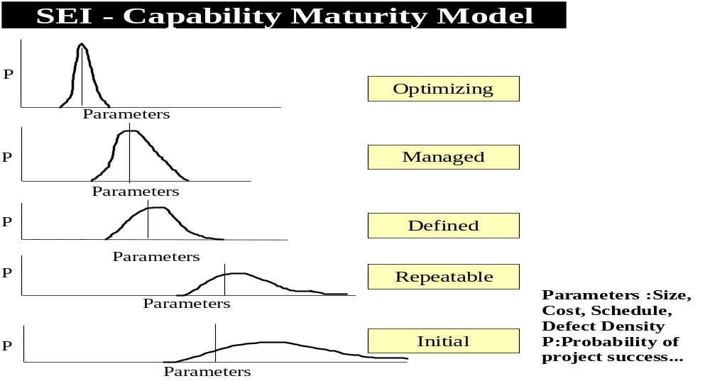
CMM and Levels

Slide 13
KPA Overview
Initial
Repeatable
Defined
Managed
Optimizing
Requirement Management
S/w Project Planning
S/w Project Tracking and Oversight
S/w Quality Assurance
S/w Configuration Management
Subcontract Management
Org. Process Focus
Org. Process Definition
Training Program
Integrated S/w Management
Inter Group Coordination
S/w Product Engineering
Peer Review
Quantitative Process Management
S/w Quality Management
Defect Prevention
Technology Change Management
Process Change Management
Basic project management processes are established to track cost, schedule and functionality. The necessary process discipline is in place to repeat earlier successes on project with similar applications.
The S/w process for both management and s/w engineering activities is documented, standardized and integrated into a standard software process for the organization. All projects use an approved, tailored version of the organization;s standard software process for developing and maintaining software
Organization has good understanding of its process capability in terms of statistical analysis
Project use the statistical data extensively & systematically to manage the projects
The measurement focus on processes as well as products
The org. is in state of continuous process improvement
based on the data collected organization wide.
Evaluating & inducting leading edge technologies & tools.
Eliminating defects / problems systematically.

Slide 14
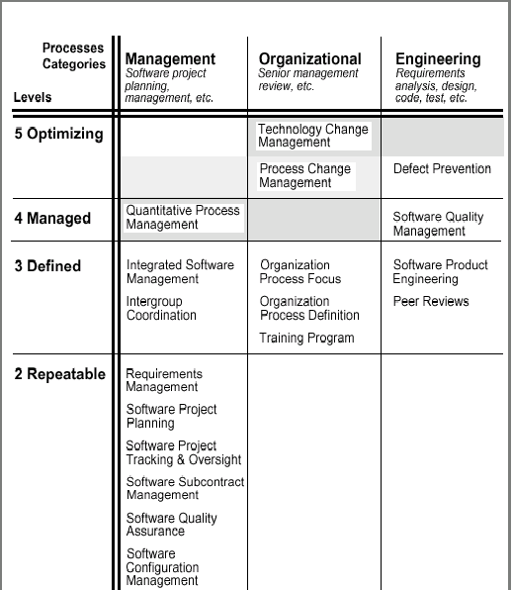
Key Process area assigned to
Process Categories

Slide 15
Goals
Goals summarize the key practices of the key process areas
They are considered important for enhancing process capability for that level of maturity
They can be used to guide organizations and appraisal teams in assessing alternative ways to implement key process areas
Each key process maps to one or more goals

Slide 16
Common Features: Factors in
Implementation and Institutionalization
Commitment to perform: institutionalization
are the activities supported by the organization through documented policies, processes, or procedures?
Ability to perform: institutionalization
are the activities supported by adequate training and resources?
Activities performed: implementation
are effective activities performed to satisfy the goals?
Measurement and analysis: institutionalization
are measurements used to determine the status of activities, and can those measurements be used to analyze the process for improvement?
Verifying implementation: institutionalization
are there processes or mechanisms for verifying that the activities are being performed?

Slide 17
What Is an Assessment?
An appraisal, by a trained team of experienced software professionals, of an organization's current software process, based on:
  Responses to maturity questionnaire
  Review of QMS
  Initial Document Review (IDR) of 4 or 5 key projects
  In-depth discussions with project leaders, middle managers, and practitioners
  Collective assessment team knowledge and experience
  Report of findings
    Assessed maturity level
    Detailed findings on CMM key process areas and non-CMM process issues
Notes:
12
What is an Assessment? First, what isn't it?
It is not an IG inspection or an audit.
It belongs to the organization's software people. If confidentiality is not maintained, forget the whole thing.
The assessment team must have a broad range of knowledge and experience and have different points of view within the organization.
Findings are summarized and reported. Details are never reported, not even the "good" stuff" - since that implies who did good and who is not doing good.
Once the recommendations are in, plans must be laid for improvement. It is not as easy as it seems to start improvements.

Slide 18
Assessment Objectives
Understand the organization's current software engineering practices.
Identify key areas for process improvement, based on the CMM.
Facilitate the initiation or continuation of process improvement activities.
• Provide framework for action.
• Help obtain management sponsorship and support.
• Help establish support and buy-in at all levels for improvement efforts.
Notes:
13
The assessment should give you a picture of where you are now, what major, key areas you need to concentrate on first, and it will build support for making those changes.

Slide 19
The Improvement Process
established SEPG works as a nucleus of a process improvement infrastructure
entire organization gets involved in process improvement
action plan is developed and resources are allocated
prioritize improvements
institutionalize good practices across organization
plan for the next assessment*
Notes:
30
Doing these simple things are what breaks down most improvement efforts. They are simple to say, and hard to maintain, since they take time and resources.
{read the list}

